Slide 1
Terrorism & Happiness
Guangyan Yu

Slide 2

Introduction
Though terrorism is not common in our country, it do exist and influence people’s life. Though terrorism is not the only factor affecting happiness, it may have some contribution.
With Happiness report and terrorism database in 2017, let’s explore the global terrorism situation and how these attacks influence people’s life.
We got data from “The Global Terrorism Database” and “The Gallup World Poll ”

Slide 3
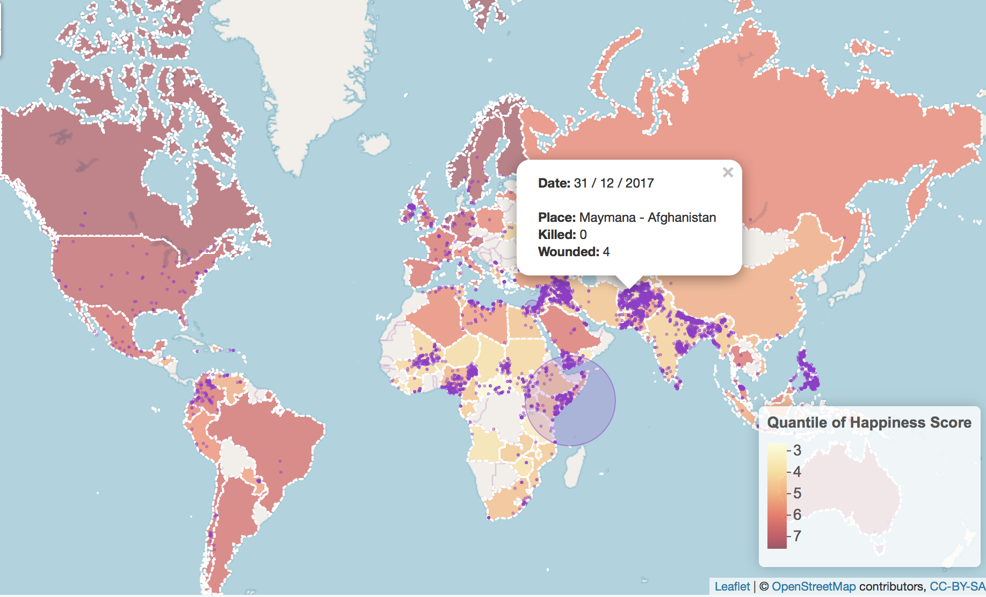
Overview
Through the map, we can have a straight overview of global terrorism and happiness.
Obviously, Middle East, North Africa, and South Asia have concentrated attacks, also happiness scores these regions are low.

Slide 4
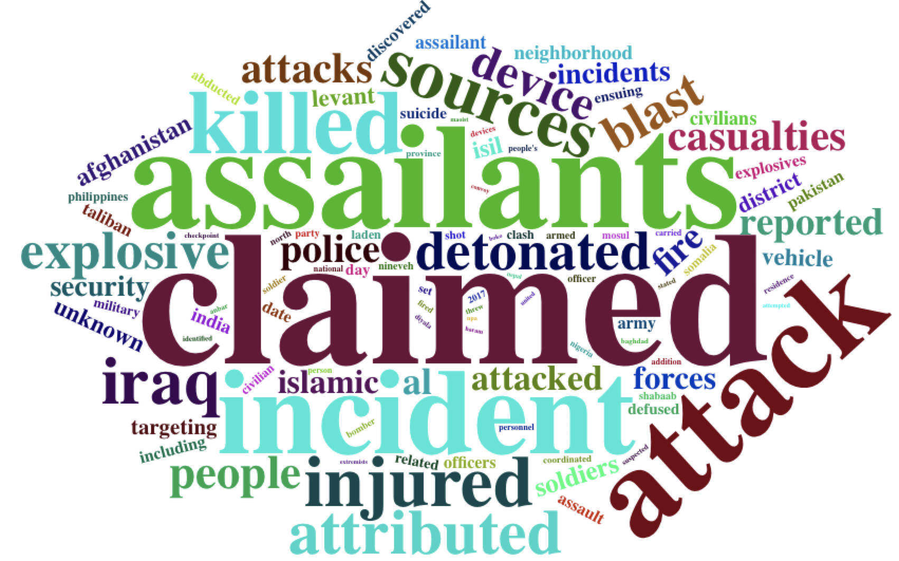
Word cloud
This is a word cloud of terrorism description.
We can find “Iraq”, “explosive”, ”police”, ”islamic”, ”Afghanistan“ …,etc are the most common words.
Iraq and Afghanistan are countries with frequent attacks.
Police is always the target of attacks.
The islamic has a great proportion in the participants of attacks.
The frequent type of attack is explosion

Slide 5
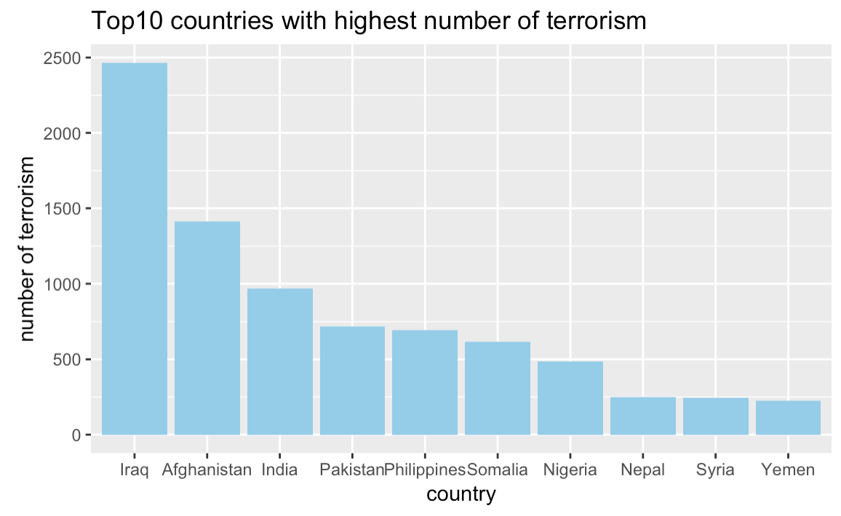
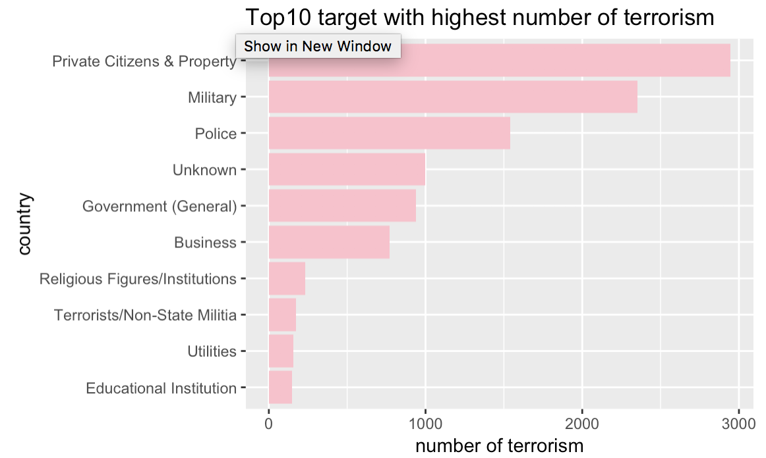
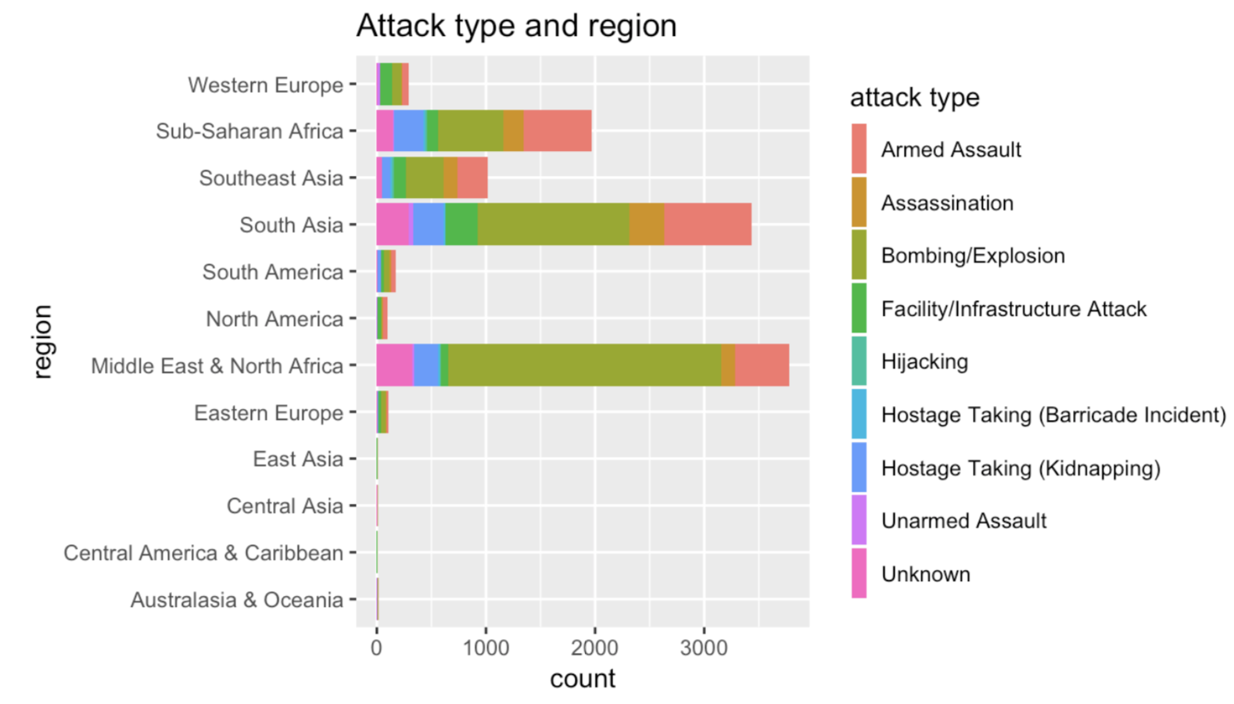
Attack analysis
The result of these plots are assistant with the word cloud.
Iraq and Afghanistan are top 2 countries with attacks.
Police is the third favorite target of terrorism.
Armed Assault and Bombing/Explosion are top 2 types of attacks.

Slide 6
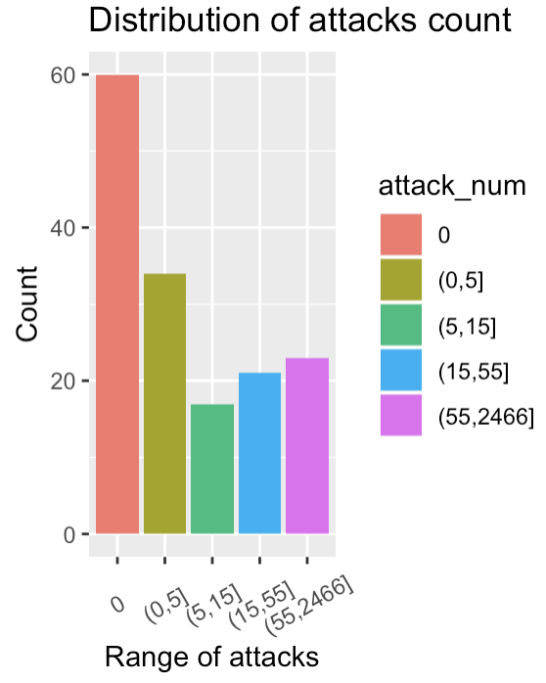
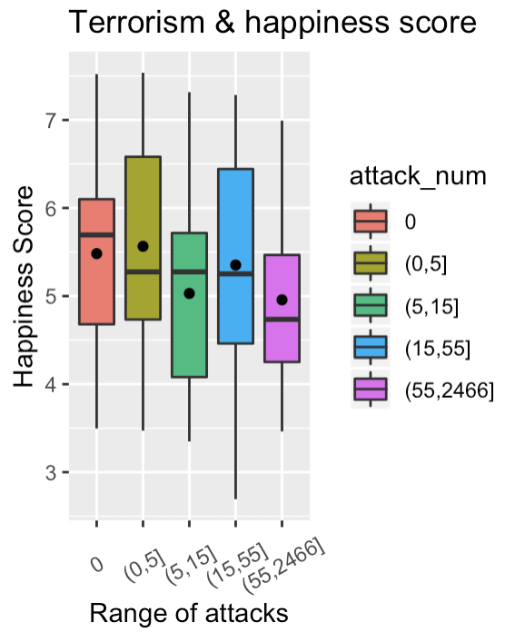
Terrorism vs Happiness
From the distribution plot we can see that every group have enough sample size.
The dot of each group represents the average happiness score of that group.
With growing of number of attacks, if there is no big gap in the number of attacks, the happiness score show no decreasing trend. But if the attacks count increases significantly, the happiness score would correspondingly decrease.

Slide 7
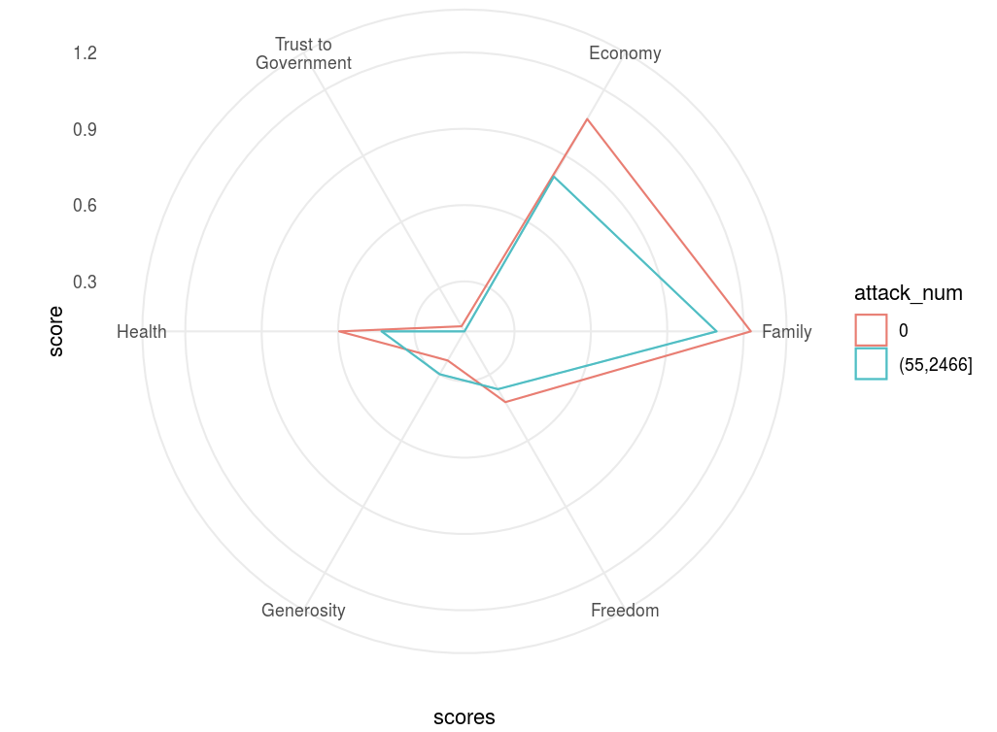
Terrorism vs other social scores
In the radar plot, 6 dimensions are 6 aspects related to the happiness of people.The more the scores, the higher extend to which people satisfied with that aspect. It shows situations of countries with 0 attacks and more than 55 attacks.
We find that countries with less terrorism have higher scores in "Freedom","Health Life Expectancy","Economy GDP","Family", and "Trust to Government, indicating that countries with less terrorism have better situation in these 5 aspects.
Only the aspect "Generosity" have the highest score in countries with attacks more than 55, which is weird.

Slide 8
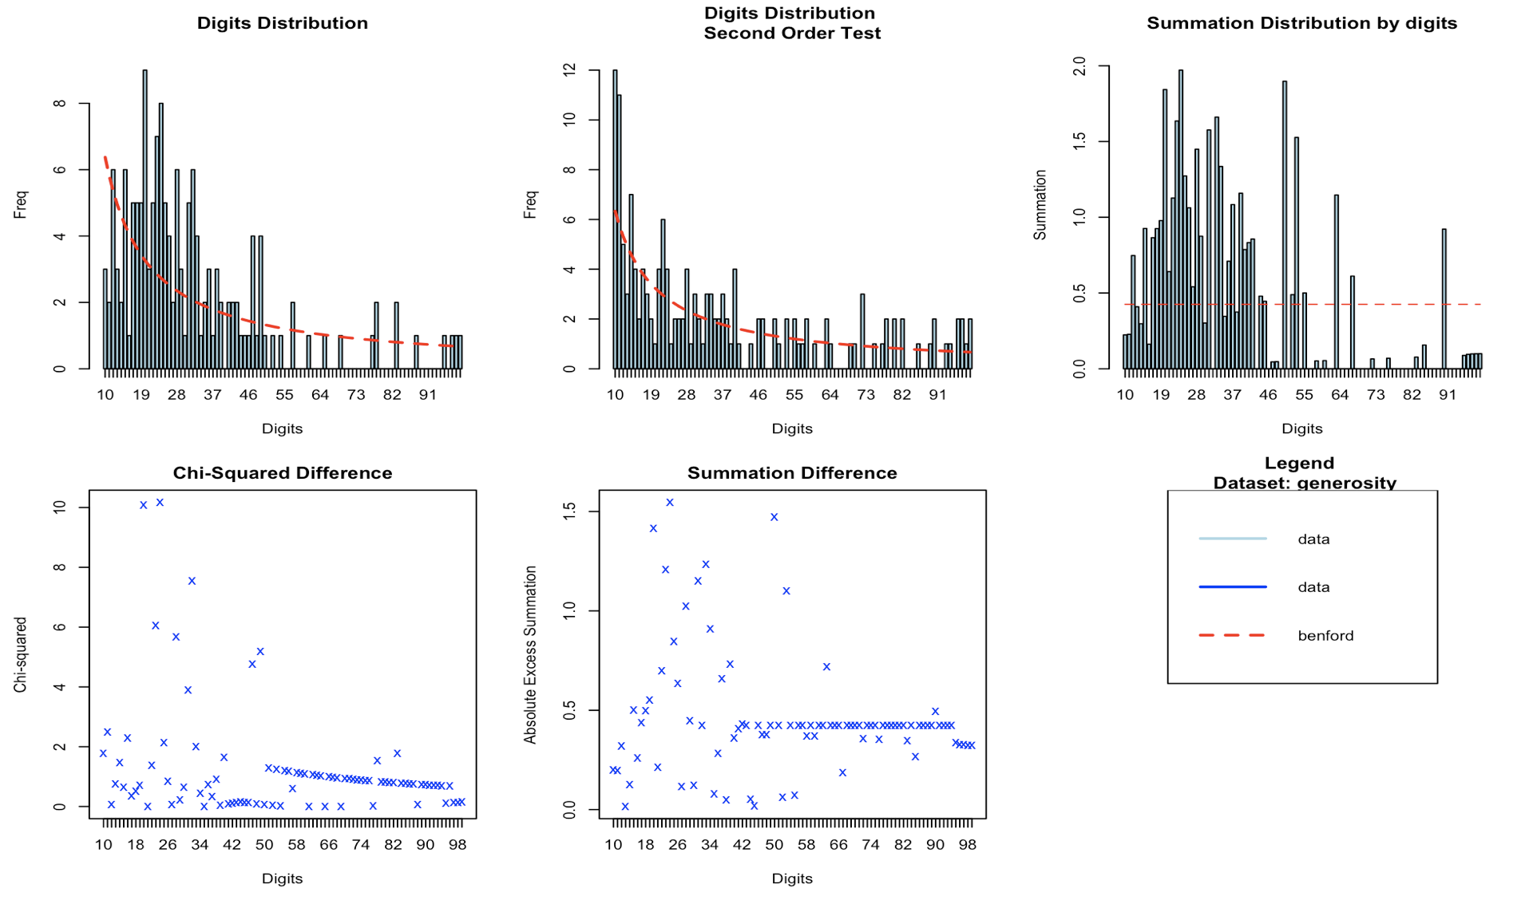
Benford Law
We can see some difference between our data and benford law from the first digits distribution plot.
However, the Second order of digits distribution is almost consist with Benford Law.
Then we explore the distribution of generosity.

Slide 9
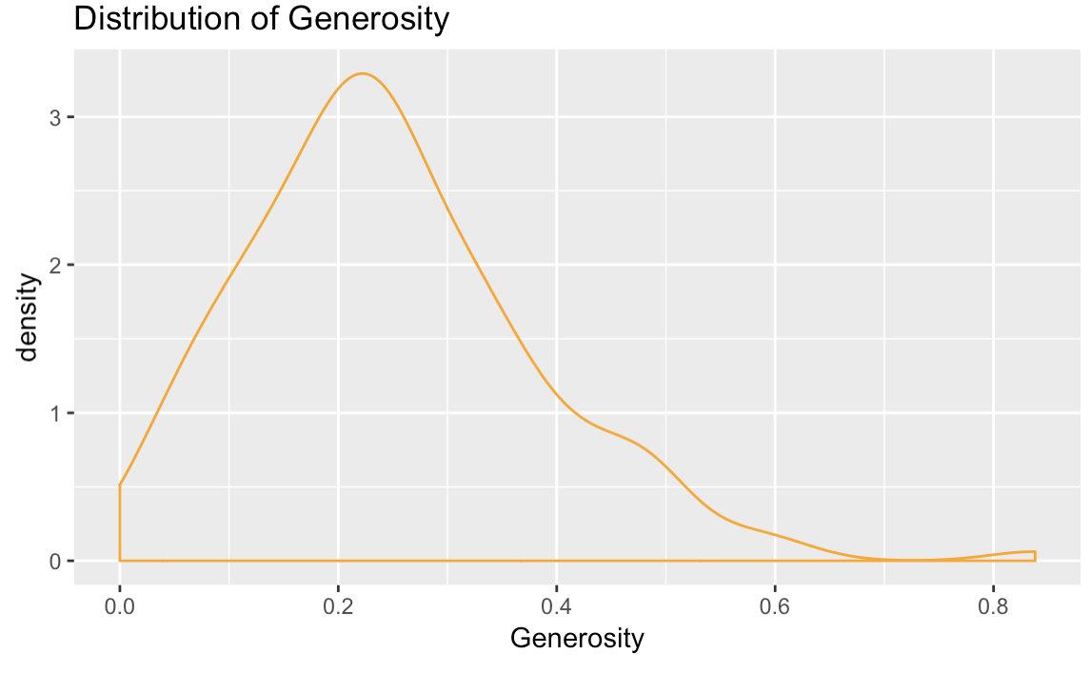
Benford Law
The distribution of generosity score is almost symmetric, consist with our common sense.
We believe that the data is reliable.

Slide 10

Conclusion
1. Iraq is a country with most frequent attacks.
2. Police is always the target of attacks.
3. The islamic has a great proportion in the participants of attacks.
4. Middle East, North Africa, and South Asia have concentrated attacks, and at the same time, happiness scores in these regions are low.
5. Happiness score is negative correlated with number of terrorism when comparing countries with enough difference in number of terrorism.
6. Countries with less terrorism are more satisfied in Freedom, Health Life Expectancy, Economy GDP, Family, and Trust to Government.
7. Data of generosity in Happiness is reliable.

Slide 11
Thanks!

